Slide 1
Programming Fundamentals
Lecture 14

Slide 2
Objectives
Classes, Objects and Memory
Defining the member functions outside the class
The scope resolution operator
Advantages of defining the member functions outside the class
Passing and Returning Objects from Functions
Array of Objects
Default and overloaded constructor calling in array of objects

Slide 3
Class, Objects and Memory
Every object of class has separate data
  When an object is created the memory is reserved for it and amount of memory depends on the attributes of the object
What about the functions of a class?
  All the objects share the same function
  A function is saved in the memory once and every object can access it without the reservation of any extra memory

Slide 4
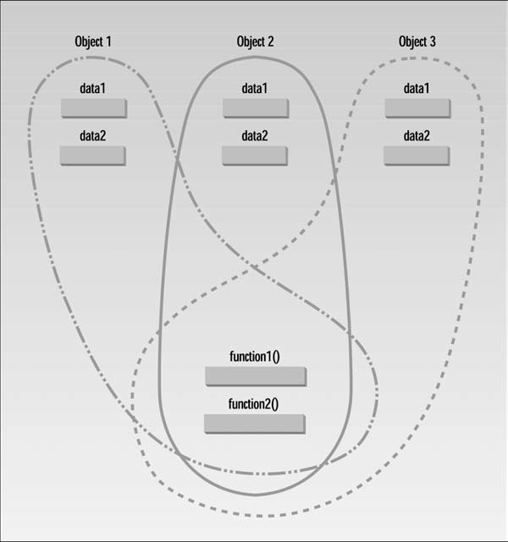
Class, Objects and Memory

Slide 5
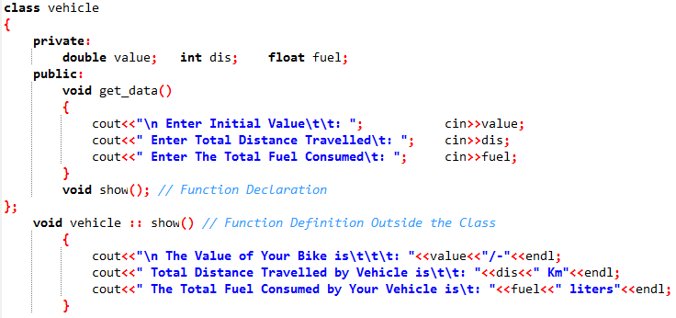
Defining Member Functions Outside the Class
In OOP we have the luxury to define any member function outside the class
To define a function outside the class we just need to declare the function inside the class and then define it outside the class by using scope resolution operator

Slide 6
Where to Define the Member Functions?
The member functions defined inside the class are compiled as inline functions
The functions outside the class not treated as inline
Normal convention is
  If the definition of function is more than 5 lines then define it outside the class
  If there are several member functions then we prefer to define the them outside the class

Slide 7
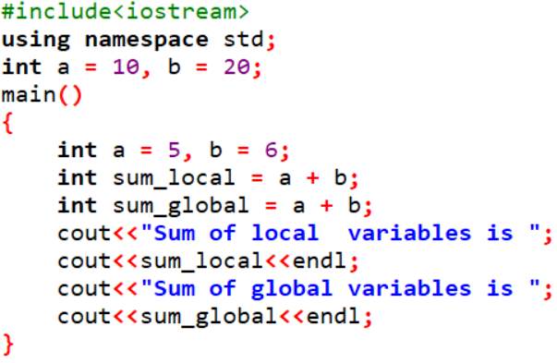
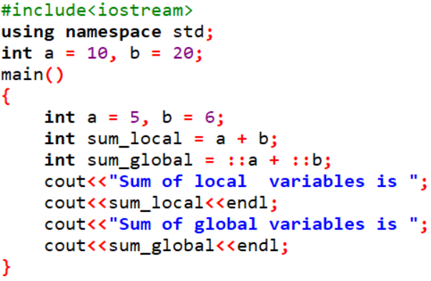
Scope Resolution Operator
Scope resolution operator(::) is used to link a function with a class or when we want to use a global variable but also has a local variable with same name
Both times the local variables will be added and 11 will be displayed
Now local and global variables will be added separately and 11 and 30 will be displayed

Slide 8
Advantages of Defining Functions Outside the Class
If there are several functions and all of them are defined inside the class then it will be very confusing for a person who want to understand it
So by defining function outside we can differentiate between interface and implementation and this will help the relevant user a lot
The other advantage is the functions defined outside the class can be accessed from derived classes

Slide 9
Passing Objects as an Argument
Any valid data type can be passed as an argument to a function
As we have seen earlier that C++ objects are just like user defined valid data types
So Objects can be passed as formal parameters
Consider the given example (objects_as_argument) in which we are going to add two vehicles
Normally a function has the access to the variables of a particular object
But if we pass the object as an argument then the function will have the access to all the variables of the object which is passed as a parameter

Slide 10
Returning Objects from Functions
We can return the objects from the functions
For this purpose we need to declare a temporary object inside the function
Then perform any action on attributes (by using dot operator)
And finally return the temporary object by using the return keyword
See the example named “returing_object_from_functions”

Slide 11
Practice Problem 1
Write an OOP based C++ code to add two complex numbers (real part is integer and imaginary part is float)
The function for addition is having only one parameter
Input the values for two complex numbers and then store the result of addition in third object
Display the complex numbers and their addition in the end

Slide 12
Array of Objects (1/2)
When we need to create a large amount of data of the same type we use arrays
Like other data types if we need to create a large amount of objects of the same kind then array is a useful option
Arrays save time by reducing the need of declaring and identifying several objects
Just by declaring an array we can get a large database of desired objects
Like other data types the arrays of objects can be one dimensional or multidimensional
For time being we will focus on just 1D arrays of objects

Slide 13
Arrays of Objects (2/2)
Example
  Consider that you are implementing the class vehicle
  Previously we just created single objects for bike, car and jeep
  Now suppose that we want to find the value, distance and fuel for 2 bikes, 10 cars and 6 jeeps
  One solution is declaring 18 objects separately, but it is time consuming
  So we will declare the 1D arrays
  2 objects bike1 and bike2 can be declared (or we can declare an array of 2 objects)
  Then an array of 10 cars will be declared like (vehicle car[10])
  And finally an array of 6 jeeps will make the life easy for us. The jeeps will be declared as (vehicle jeep[6])
Have a look at the attached .cpp file “array_of_objects” execute it and answer the question given on next slide

Slide 14
Array of Objects – Example
Execute the code and answer the followings
  How many times the default constructor is called?
  How many times the overloaded constructor is called?
  Can we initialize the objects with different values in array?
  How we can create the array of objects which are accepting some arguments?
  Modify the code to show the data stored in 2 bikes, 10 cars and 6 jeeps

